Slide 1

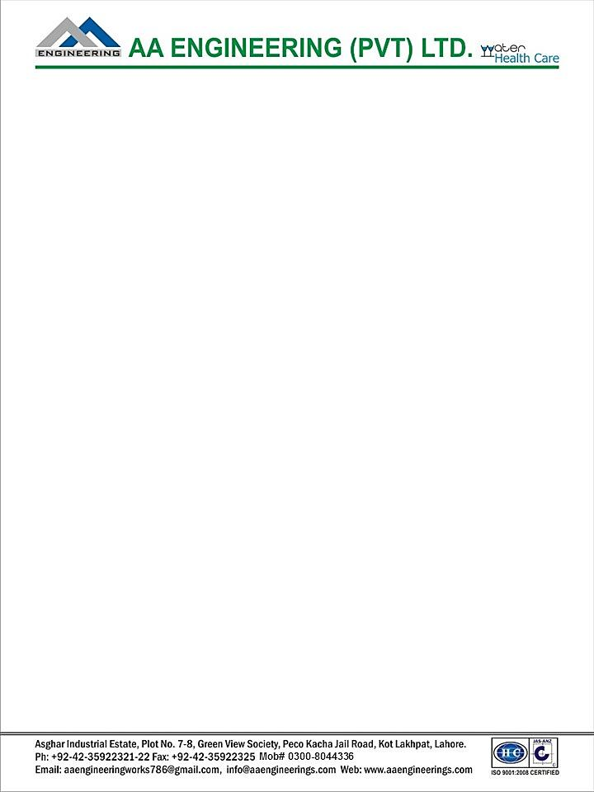

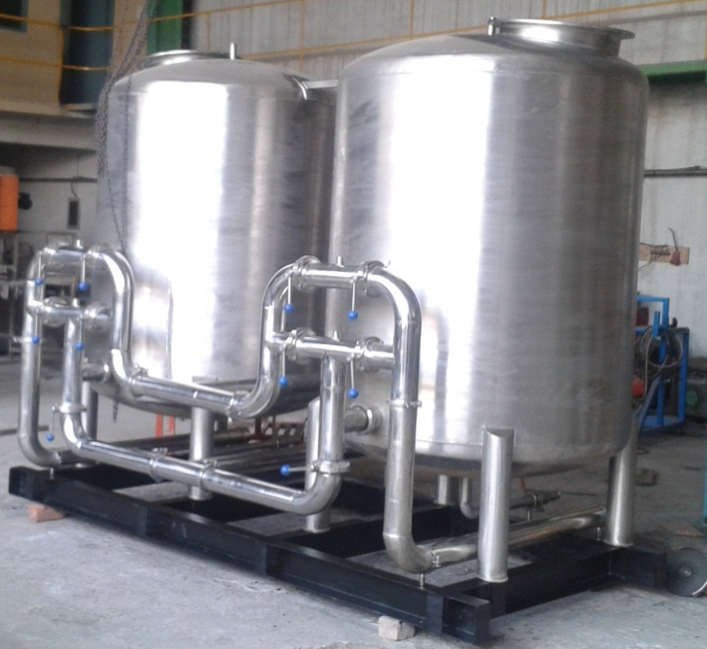
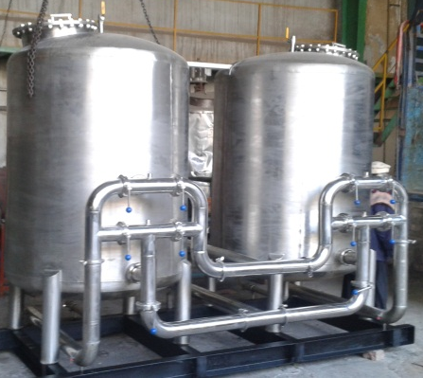
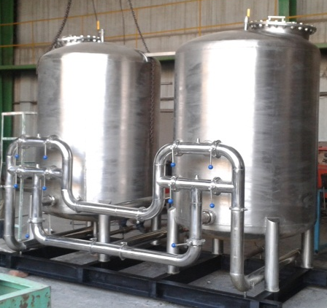
Ch. Amjad Ali
Chief Executive
Ref#: AAE/21/401
Carbon filter system
Manufactured and Installed by AA Engineering (Pvt.) Ltd.
For
M/s NESTLE Pakistan
at Kabirwala
Carbon Filter System:
(Granular Activated Carbon) used in this filter should be specially graded for water purification. It should have the capability to adsorb most of the organic chemicals, chlorine, insecticides, pesticide, THMs, TCE and PCBs etc. It should remove odor and gives water a natural taste. The system should provide adequate distribution to uniformly expand the filter bed during backwash and entire media bed should be utilized during the filter cycle.

