Slide 1

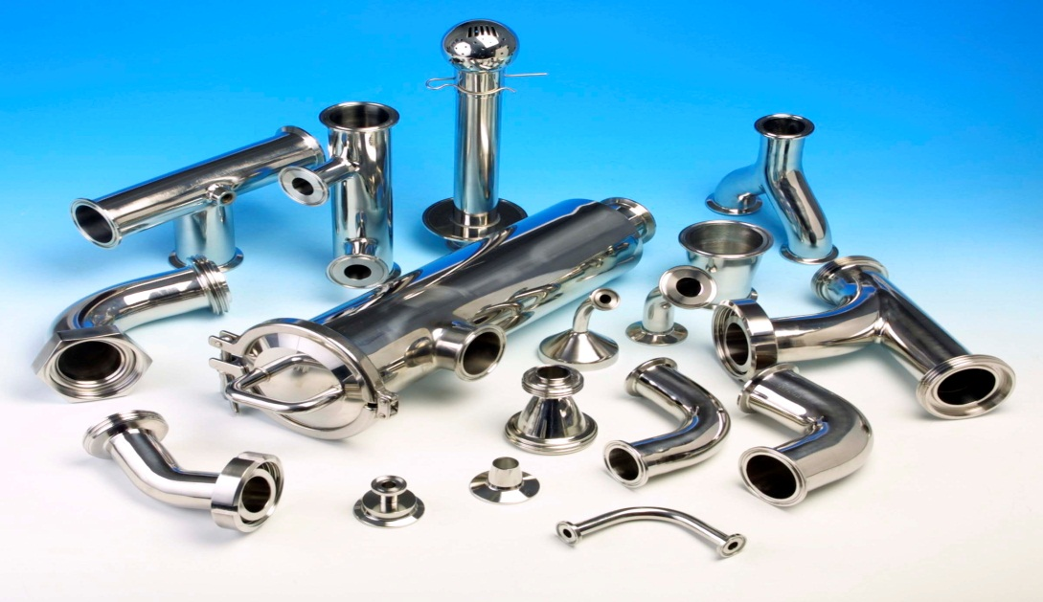
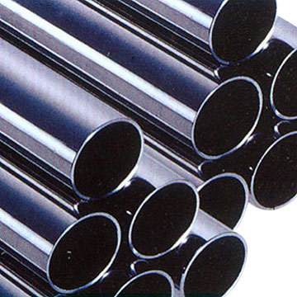
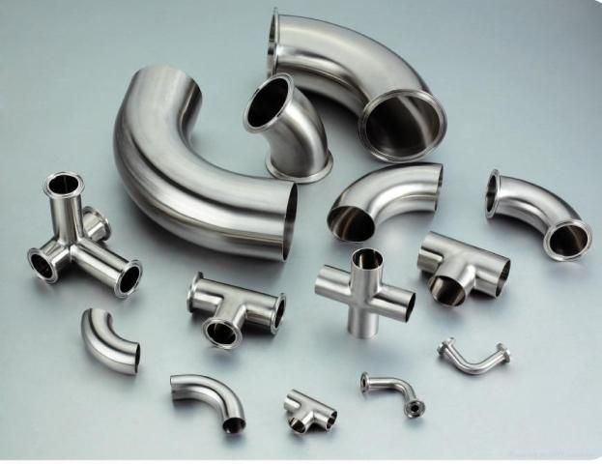
Ch. Amjad Ali
Chief Executive
Ref#: AAE/21/398
SS PIPING & FITTING
Stainless steel pipe fittings are the collective name of various stainless steel pipe connection work pieces, which can be divided into different categories according to shape, purpose, and connection method. It has the characteristics of easy installation, high performance, durability, etc. and has a wide range of applications in various pipeline construction and installation.
AA Engineering (Pvt.) Ltd. specializes in the production of Stainless Steel pipes and Fittings, elbows, tees, crosses, heads, reducers, flanges, caps, and heads.

