Slide 1

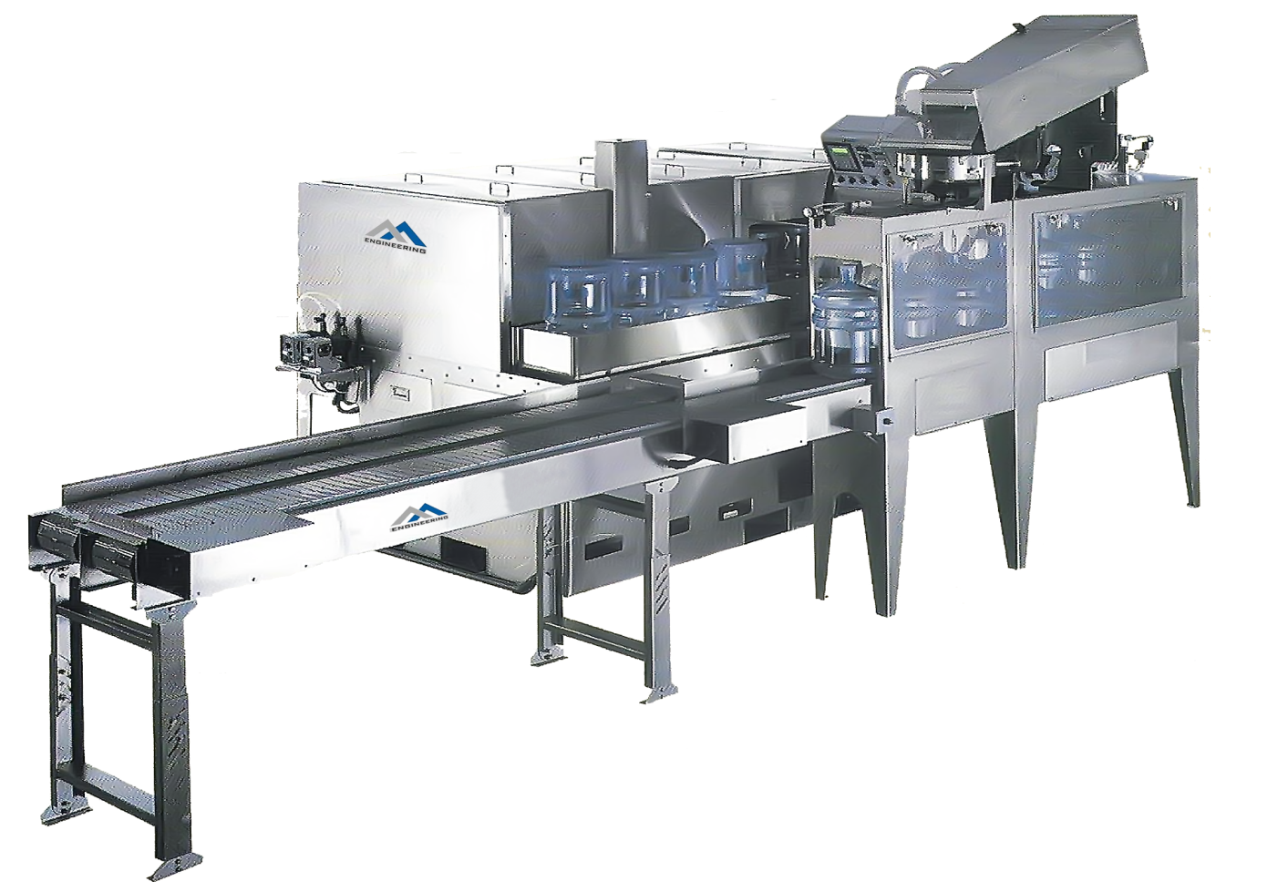
Ch. Amjad Ali
Chief Executive
Ref#: AAE/21/396
05 GALLON BOTTLE FILLING PLANT
(High Speed Capacity 100-1200 BPH)
Model | AAE-100 | AAE-200 | AAE-300 | AAE-450 | AAE-600 | AAE-900 | AAE-1200
Filling heads | 1 | 1 | 2 | 3 | 4 | 6 | 12
Volume(L) | 18.9 | 18.9 | 18.9 | 18.9 | 18.9 | 18.9 | 18.9
Barrel size(mm) | 270×490 | 270×490 | 270×490 | 270×490 | 270×490 | 270×490 | 270×490
Capacity | 100B/H | 200B/H | 300B/H | 450B/H | 600B/H | 900B/H | 1200B/H
Motor power(KW) | 1.38 | 1.75 | 3.8 | 3.8 | 7.5 | 9.75 | 13.5
Rated voltage | 380V/50HZ | 380V/50HZ | 380V/50HZ | 380V/50HZ | 380V/50HZ | 380V/50HZ | 380V/50HZ
Weight(KG) | 600 | 700 | 1200 | 2000 | 2800 | 3200 | 4000

