Slide 1

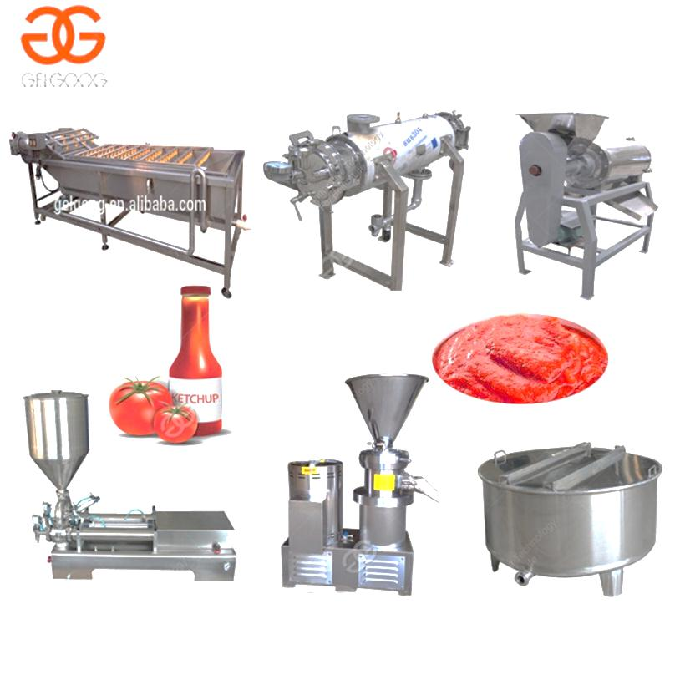
TOMATO PASTE / PUREE PROCESSING MACHINE
Ch. Amjad Ali
Chief Executive
Ref#: AAE/21/388
Introduction:
Whole tomato paste production line to make the tomato paste sauce, puree, ketchup, fruit paste, etc. Automatic and high efficient.
With different capacity of: 300kg/h, 500kg/h. etc.
THE FLOW PATH OF TOMATO PUREE MAKING MACHINE:
CLEANING-PREHEATING-BEATING-GRINDING-MIXING-STERILIZING-PACKING
Technical Data:
Type: Tomato Paste Production Line
Capacity: 250kg/h
Voltage: 220V/380V
Power: 1.5kw
Weight: 500kg
Dimension(L*W*H): 1560*450*1340mm
Function: Multifunction

Slide 2
TOMATO PASTE / PUREE PROCESSING MACHINE
Ch. Amjad Ali
Chief Executive
Ref#: AAE/21/387
Introduction:
Whole tomato paste production line to make the tomato paste sauce, ketchup, fruit paste, etc. Automatic and high efficient. With different capacity of: 300kg/h, 500kg/h. etc.
Sr. No. | Product Name | Capacity | Dimensions (mm) | Function
1 | Bubble Cleaning | 2T/Hr | 255x1100x1800 | Hoist passive wheel with a tension device
2 | Sorting Machine | 2T/Hr | 3500x800x900 | Both side with waste collection bucket
3 | Elevator | 2T/Hr |  | To enhance transportation for tomato
4 | Crusher Pump | 0.5-2m3/Hr |  | Pressure ≥4.5Mpa
5 | Column Tubular | 2T/Hr | 1405x615x1250 | Preheating
6 | Beater Machine | 1-1.5T/Hr | 1450x770x1530 | Automatic separation of slurry residue
7 | Temporary | 1000 L |  | Interim storage
8 | Beverage Pump |  | 350x265x320 | For juice fluid transport
9 | Colloid Mil | 1-2T/Hr | 990x650x1340 | Used for juice pulp grinding refinement
10 | Storage Tank |  | 1000L | Interim storage
11 | Mixing Tank | 0.1-0.2T/Hr | 500L | For fruit pulp ingredients, add sugar and other accessories
12 | Sugar Process | 100L | 1200x1200x2100 | Temperature ≤ 100˚C
13 | Homogenizer | 1000L/Hr | 1300x820x1200
14 | Vacuum | 100L/Hr | 800x600x2000 | The centrifugation film speed: 100-500 R/Min.
15 | Column Tubular | 1T/Hr | 1220x440x1080 | The discharge temperature: 90-95 ˚C
16 | Aseptic Product |  | Ø 38mm | Single closed tank
17 | Control Cabin |  | Diameter Ø50 | With leakage protection and overload protection

