Slide 1

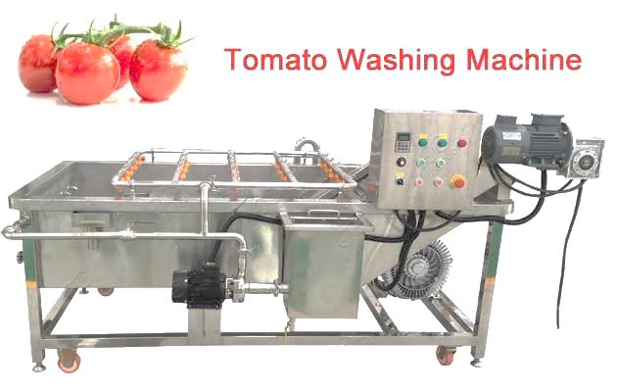
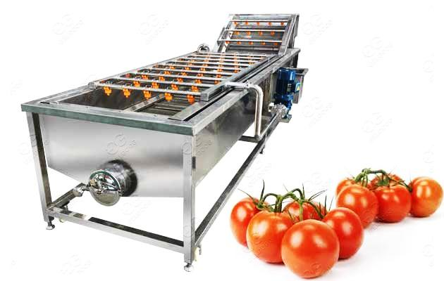
AUTOMATIC TOMATO WASHING MACHINE
Ch. Amjad Ali
Chief Executive
Ref#: AAE/21/387
Introduction:
Tomato washing machine is used to sterilize tomatoes and clean tomatoes. This automatic tomato washing machine can be used alone or with other tomato processing equipment, such as tomato classifier, tomato juicer, tomato sauce production line, etc.
Technical Specification
Model # | Power (KW) | Size (MM) | Weight (KG) Max. | Mesh Width (MM)
AAE/TWM/01 | 2.2/0.75/1.5 | 3100x1400x1500 | 500 | 600
AAE/TWM/02 | 4/1.1/1.5 | 4100x1400x1500 | 700 | 800
AAE/TWM/03 | 5.5/1.5/2.2 | 5100x1400x1500 | 900 | 800
AAE/TWM/04 | 5.5/1.5/2.2 | 6100x1400x1500 | 1000 | 800
AAE/TWM/05 | 5.5/1.5/3 | 7100x1400x1500 | 1200 | 800
AAE/TWM/06 | 5.5/1.5/3 | 8100x1400x1500 | 1350 | 800

