Slide 1

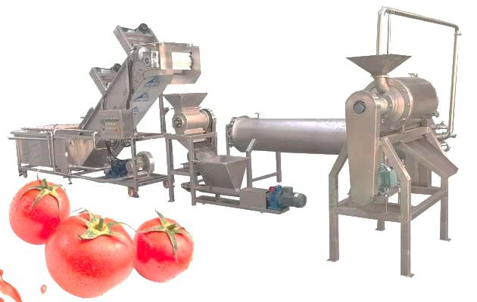
TOMATO PASTE PRODUCTION LINE
Ch. Amjad Ali
Chief Executive
Ref#: AAE/21/386
Introduction:
Tomato paste production line technical advantages:
The automatic tomato paste production line we provide is mainly fresh and mature tomatoes that are washed, lifted, sorted, crushed and beaten, concentrated and sterilized, and then filled into aseptic ketchup products after aseptic filling.
Technical Data
Hoist | Hoist power: 0.75kw Size: 2000 * 800 * 1600mm
Impurity removal machine | Size: 3000 * 1000 * 1400 Power: 5.2KW
Broken screw pump | capacity: 0.5-1 ton / hour; Power: 1.5KW; Dimensions: 1500 × 500 × 500mm;
Enzyme inactivation equipment | capacity: 1T / H Size: 1220 × 615 × 1250mm
Technical Data
Pulp machine | capacity: 1-2.5 tons / hour Power: 380V, 50Hz, 4Kw;
sandwich pans Stirring | power: 1.5KW Heating power: 24KW If the burner is configured: 10W Kcal Dimensions: 1100 * 980 * 1600 Body size: 800 * 550
Filling machine | 1200 * 350 * 350 Voltage 200-250V Frequency 50 or 60HZ

