Slide 1

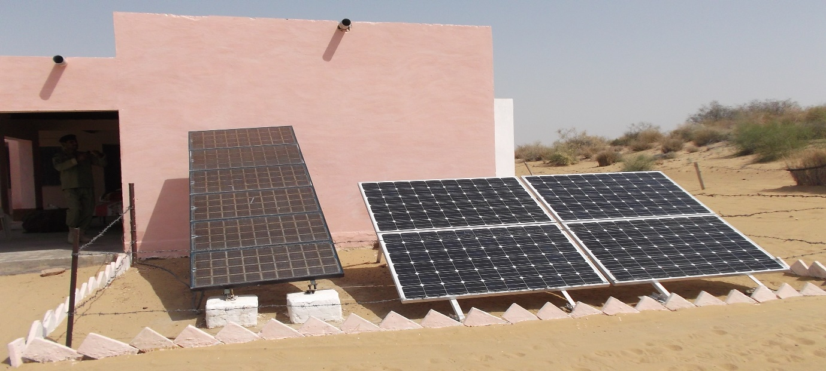
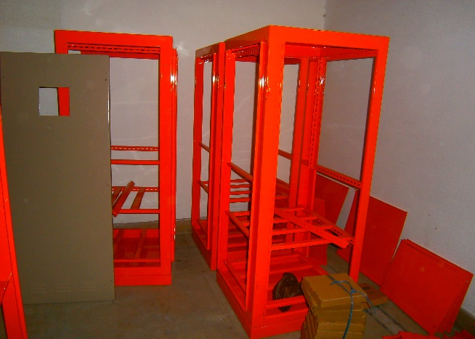
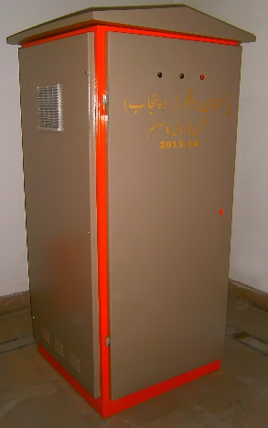
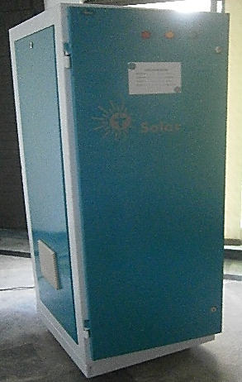
SOLAR
ELECTRICAL CONTROL PANEL
Ch. Amjad Ali
Chief Executive
Ref#: AAE/21/351
Our Solar Electrical Control Panel include all the necessary components to connect the panels to the controller and the controller to the battery bank, including combiner boxes and circuit breakers. Solar photovoltaic panels can be installed on the roof of your home/Offices/Buildings or commercial property.

