Slide 1

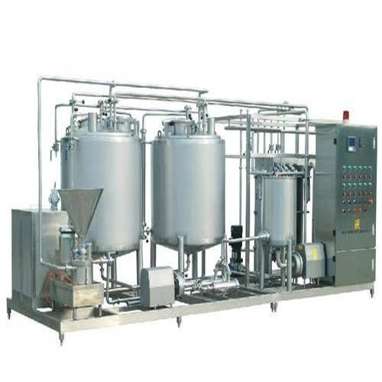
Juice Processing Machinery
(Capacity: – Min 1000 Kg /Hr Max 10,000 Kg/Hr)
Ch. Amjad Ali
Chief Executive
Ref#: AAE/21/365
Most juices are packed in aseptic packaging. Those that are intended to be kept and stored in the fridge are packed using ultra clean packing technology, and those that come in glass bottles are usually hot filled.
1. Sugar Syrup Preparation Tank
2. Fruit Pulp Storage Tank
3. Filter Press
4. Blending
5. Homogenization
6. Standardization
7. Pasteurization
8. Filling Line: – Automatic Bottle Filling Line with Rinsing Filling & Cap
Sealing Machine

