Slide 1

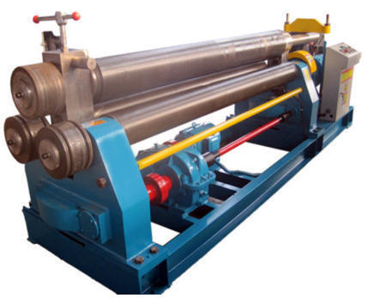
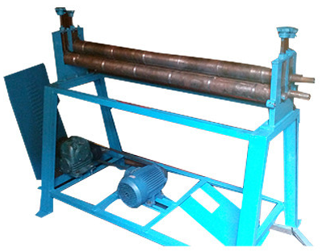
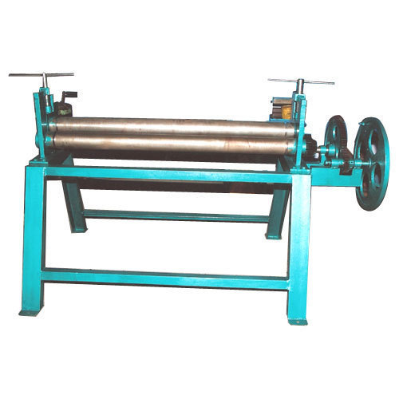
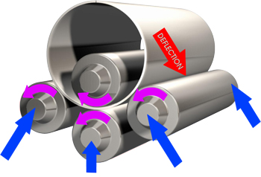
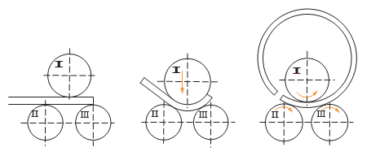
SHEET / PLATE ROLLING MACHINE
Ch. Amjad Ali
Chief Executive
Ref#: AAE/21/363
We are manufacturing of Sheet / Plate Rolling Machine to our Clients. High quality MS & SS material use make any design as per Client’s requirement.
Specifications:
Condition: New
Function: Rolling
Usage: For making body balk
in round form, Sheets for Tanks.
Features:
Longer service life
Trouble-free operation
Less power consumption

