Slide 1

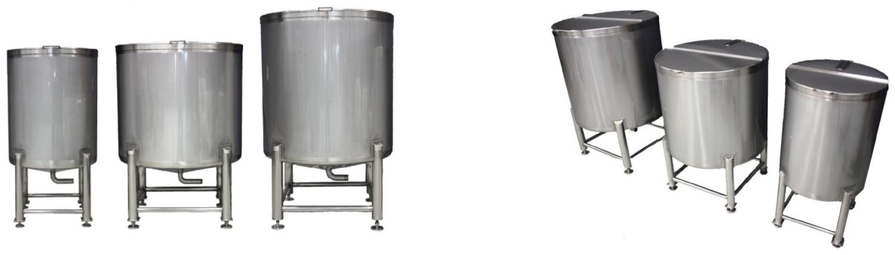
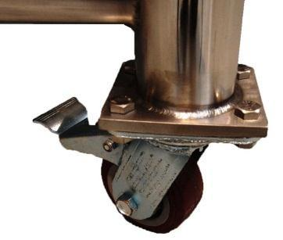
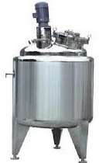
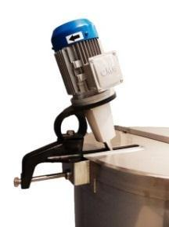
SS STORAGE & MIXING TANKS
Ch. Amjad Ali
Chief Executive
Ref#: AAE/21/362
AAE Equipment Traders hold a constant stock of SS 304 & SS 316 grade stainless steel tanks that are suitable for most industries such as food, chemical, beverage, pharmaceutical etc. As well as offering our standard range of tanks, AAE Equipment Traders can design and build custom made tanks to suit our client’s requirements. Additional tank features such as heating/cooling jackets, agitation, internal baffles are offered.
FEATURES:
Open top with split hinged & fixed lid.
50mm reinforced top.
Compensated mixing bracket to suit clamp on agitators.
All welds are ground & strip polished. Material: 2B finish.
Legs are polished with cross bracing on compensation pads.
Optional lockable castor wheels can be fitted to 500LT & 1,000LT Models.

