Slide 1

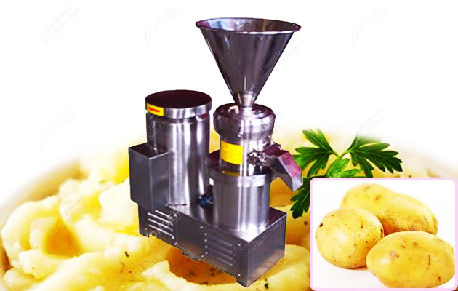
POTATOES PROCESSING MACHINE
Ch. Amjad Ali
Chief Executive
Ref#: AAE/21/361
Working Principle of Potatoes Processing Machine:
Colloid mill is the basic working principle of cutting, grinding and high-speed mixing, crushing grinding on mill tooth profile incline relative motion, one of the high speed rotating, another still make through tooth profile incline between material by shear force and friction force, at the same time, in the high frequency vibration.
Technical Data
Capacity | 100-200 kg/h
Fineness | 50-200 mesh
Power | 7.5kw
Dimension | 700x420x1000mm

