Slide 1

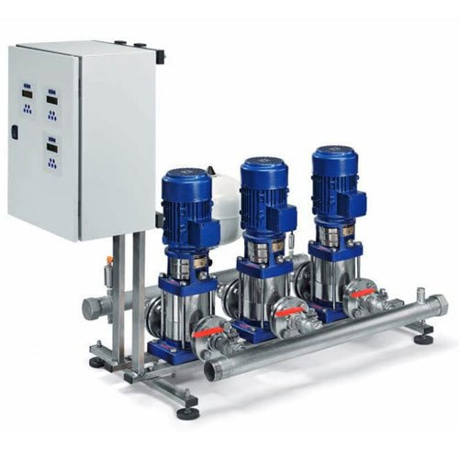
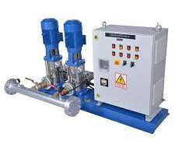
PRESSURE BOOSTING SYSTEM
Ch. Amjad Ali
Chief Executive
Ref#: AAE/21/377
Product Description
Booster Systems.
Comprehensive turnkey skid systems.
Standalone multi-pump operation.
Fixed or variable speed.
Product Specification
Usage/ Application | Water boosting & distribution, Washing facilities, fire prevention
Pump Type | Horizontal, Vertical, Borehole
Brand | Grundfoss/Lowara/ Equivalent
Motor r | 75 HP
Power Source | Electric
Material | Stainless Steel
Phase | 3 Phase, 1 Phase
Voltage | 415 V,230 V
Maximum Discharge Flow | 450 m3/h,620 m3/h
Structure | Horizontal,Vertical
Power | 35 KW
Head | 150-180 Meter
Frequency | 50 Hz

