Slide 1

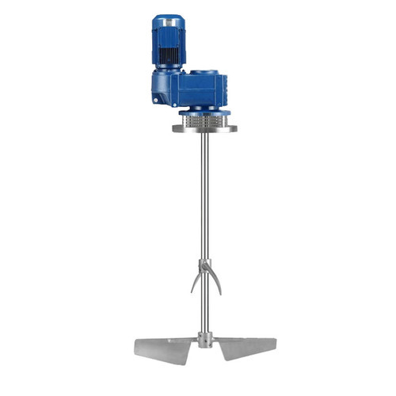
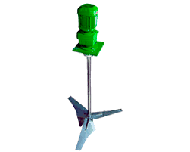
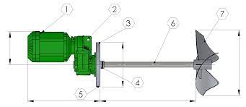
AIR AGITATOR MIXER
Ch. Amjad Ali
Chief Executive
Ref#: AAE/21/376
Product Description
Regardless of the mixing you want to perform, we have just the right mixer for you: hand hold mixer, Lab mixer, angle entry bung mixer, pneumatic lift stand mixer, time-programmed mixer etc.
Specifications:
Power | 1 - 10HP
Capacity | 1200 Liters
Material | SS 304/316
Air Pressure | 0.71Mpa
Speed | 8500 RPM
Max. Torque | 0.55N.m
Air Cons. | 265L/min
Paint Barrel | 5-10L
Axes Size | 10x190mm
Vane Size | 2”-5"
Hoist | 110mm
Net Weight | 4-5 kgs
Volte | 240/440V

