Slide 1
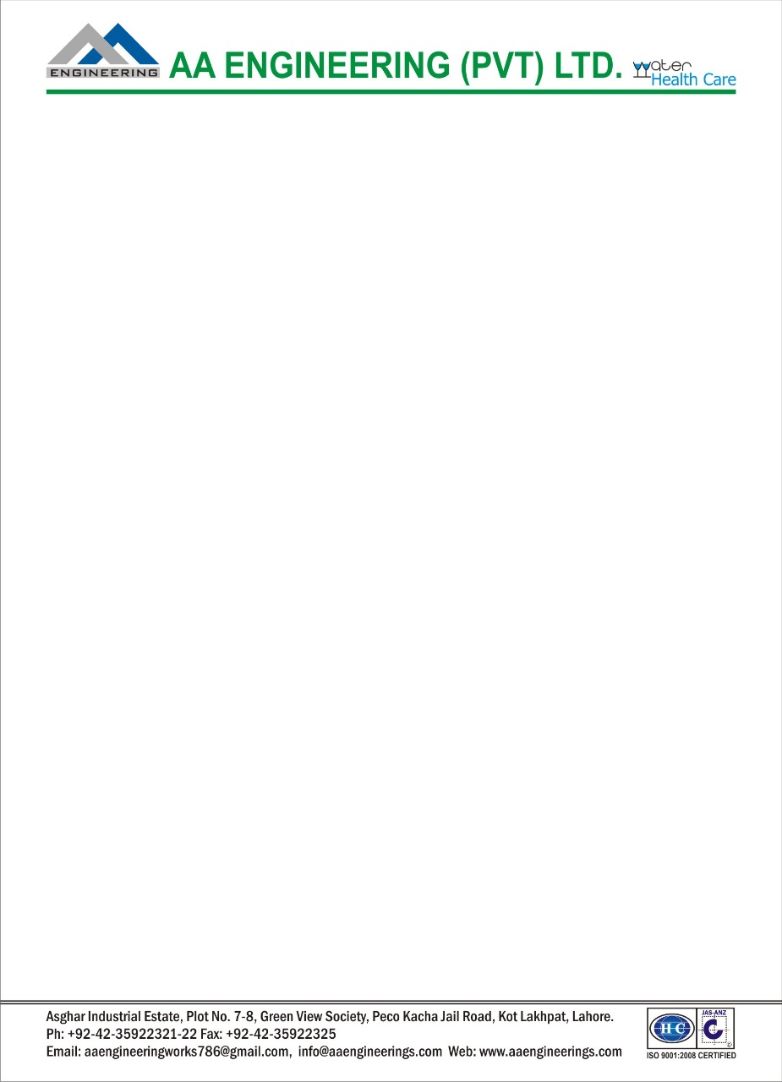
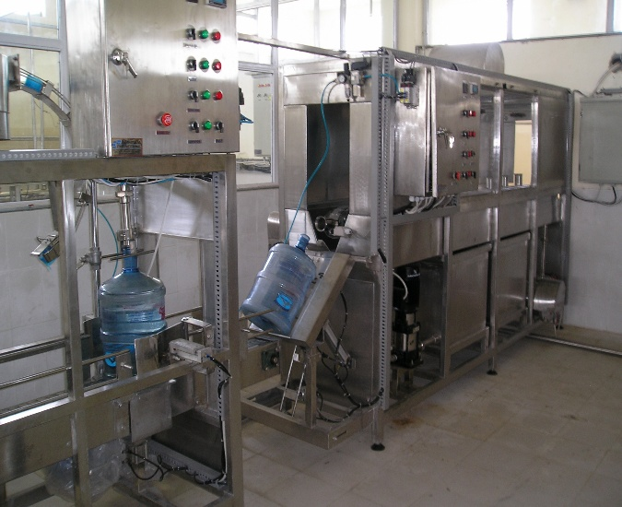
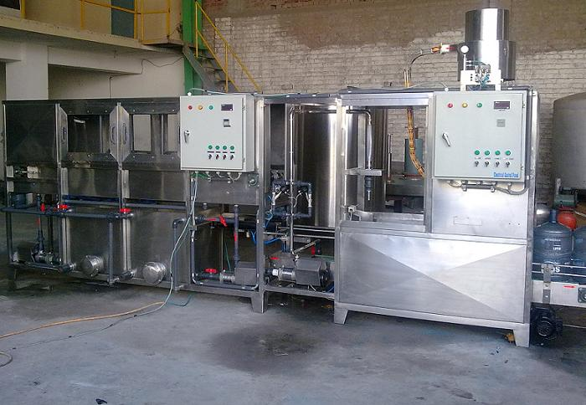
05 Gallon Bottle Filling Machine
Ch. Amjad Ali
Chief Executive
Ref#: AAE/21/375
05 gallon bottling machine is special for 05 gallons barrel drinking water production. The production line can automatic finish on line washing, bottle loading, sterilizing, filling, capping, shrinking, bagging and transport the bottles out, it is function complete, structure compact, easy operation and so on features.
Model | AAE-100 | AAE-200 | AAE-300 | AAE-450 | AAE-600 | AAE-900 | AAE-1200
Filling heads | 1 | 1 | 2 | 3 | 4 | 6 | 12
Volume(L) | 18.9 | 18.9 | 18.9 | 18.9 | 18.9 | 18.9 | 18.9
Barrel size(mm) | 270×490 | 270×490 | 270×490 | 270×490 | 270×490 | 270×490 | 270×490
Capacity | 100B/H | 200B/H | 300B/H | 450B/H | 600B/H | 900B/H | 1200B/H
Gas pressure | 0.4-0.6MPa | 0.4-0.6MPa | 0.4-0.6MPa | 0.4-0.6MPa | 0.4-0.6MPa | 0.4-0.6MPa | 0.4-0.6MPa
Gas consumption | 0.37 | 0.37 | 0.6 | 0.8 | 1 | 1.5 | 1.8
Motor power(KW) | 1.38 | 1.75 | 3.8 | 3.8 | 7.5 | 9.75 | 13.5
Rated voltage | 380V/50HZ | 380V/50HZ | 380V/50HZ | 380V/50HZ | 380V/50HZ | 380V/50HZ | 380V/50HZ
Weight(KG) | 600 | 700 | 1200 | 2000 | 2800 | 3200 | 4000
Mob: 0300-8044336

