Slide 1

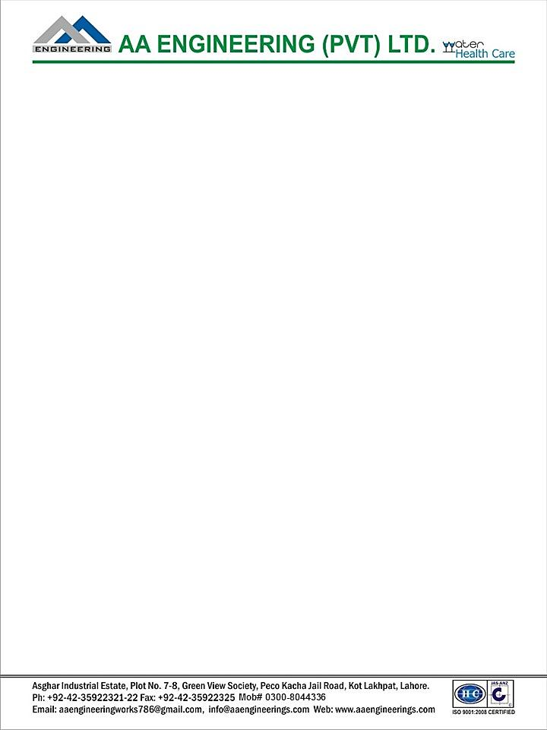
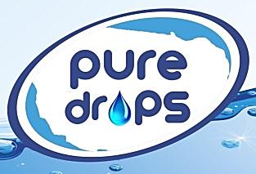
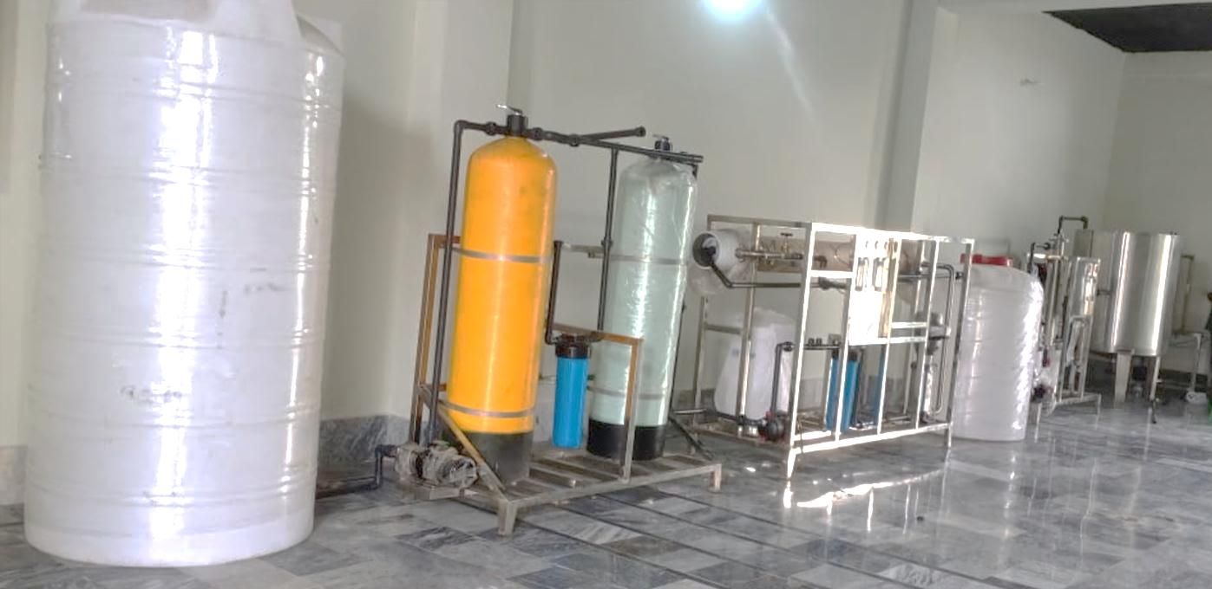
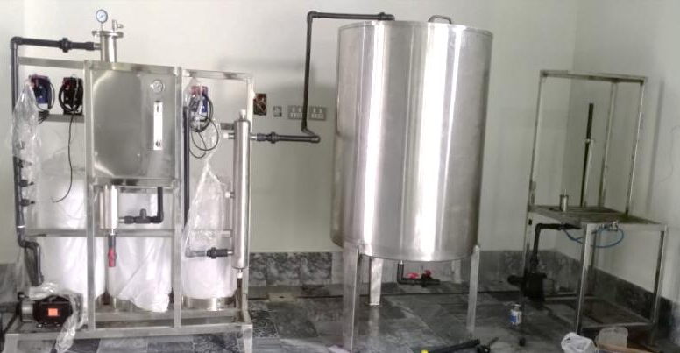
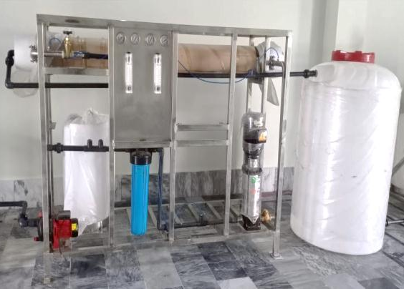
Water Treatment Plant
(2000 LPH)
Ch. Amjad Ali
Chief Executive
Ref#: AAE/21/364
Manufactured and Installed by AA Engineering (Pvt.) Ltd.
For
Pure Drops
(M/s ZH Brothers Beverages )
at Depalpur - Okara

