Slide 1

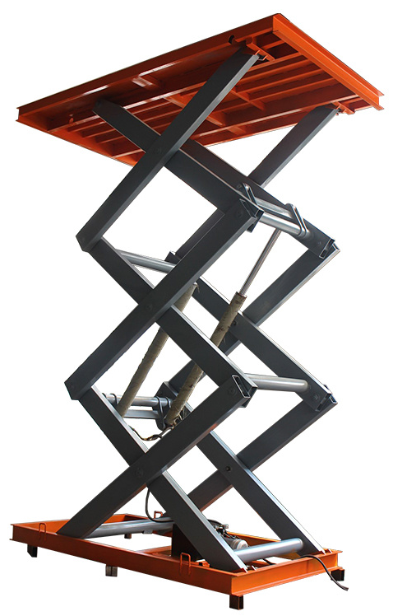
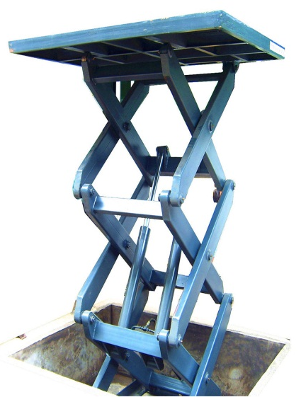
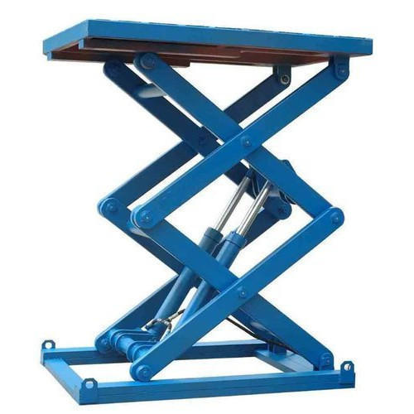
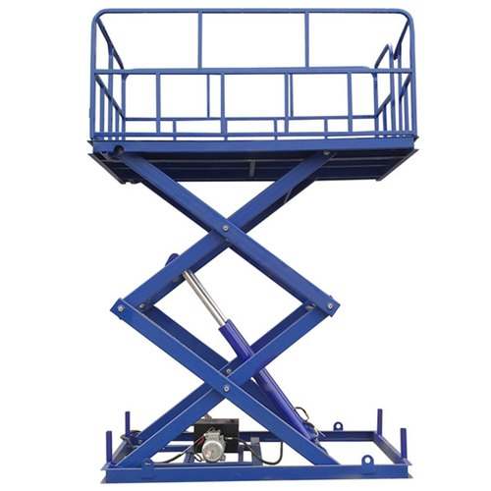
WAREHOUSE HYDRAULIC
SCISSOR LIFT
Ch. Amjad Ali
Chief Executive
Ref#: AAE/21/372
Product Specification
Capacity | 5 Ton (Customized)
Lift Type | Scissor Lift
Color | Blue (Customized)
Overall Dimensions | 1400x1100x500mm
Max. Lifting Height | 2.0 M
Feature | Low Noise Hydraulic Cargo Scissor Lift
Weight | 1500 kg

