Slide 1

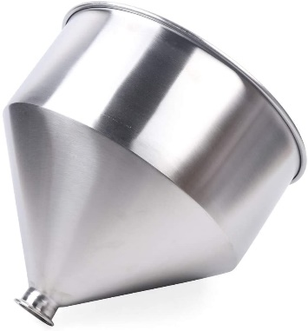
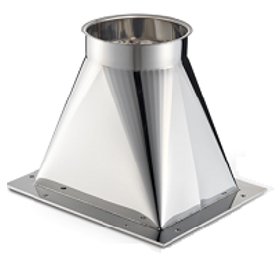
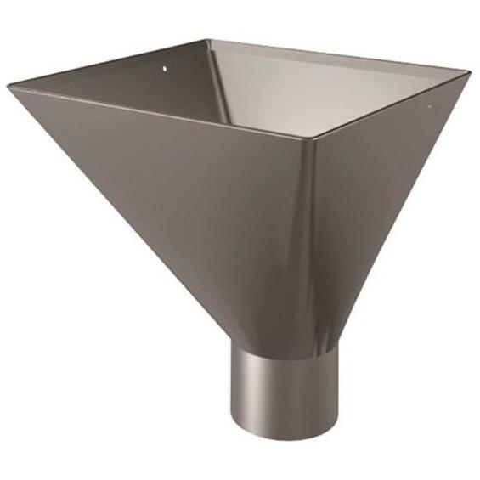
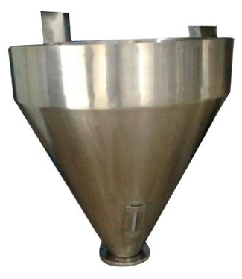
SS HOPPER FOR
FILLING MACHINES
Ch. Amjad Ali
Chief Executive
Ref#: AAE/21/354
This stainless steel hopper is applied to the liquid and paste filling machine.
SPECIFICATION:
Material: 304 stainless steel
Volume: 30L (Customized)
Outlet Diameter: 18.6" (Customized)
FEATURES:
Constructed of 304 stainless steel, food-grade material, this paste filling machine hopper has a good resistance to acid and alkali, corrosion and scratch.
This paste liquid filling machine hopper features 30L large volume, accepting a lot of filling product at one time, offering great filling performance.
The 304 steel hopper adopts excellent surface treatment technology. Polished and powder coated surface is anti-scratch, durable and easy to maintain.
Integral moulding structure makes the food-grade hopper for liquid/paste filling machine solid and durable.
Comes with a hopper lid to meet daily requests. Protect the inner space. Prevent air dust or other insect from going into the hopper.

