Slide 1

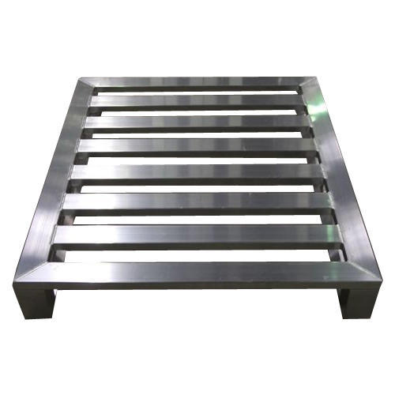
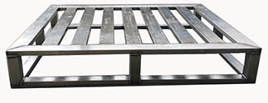
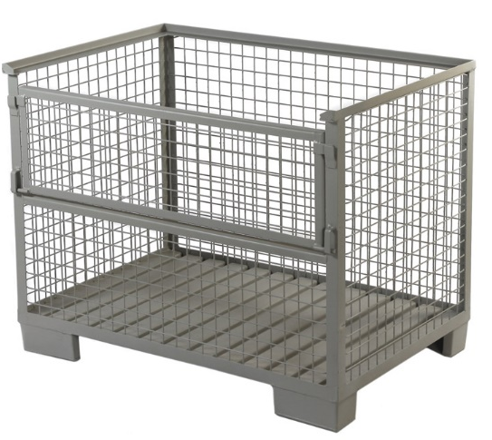
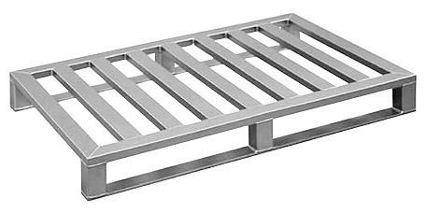
SS PALLETS
Ch. Amjad Ali
Chief Executive
Ref#: AAE/21/353
Our SS Pallets are durable in nature, best in quality and superior in performance. Meeting to optimal finishing, these pallets are reliable and supplied in the market in different sizes and shapes. Moreover to this, these SS pallets are hard framed and weather proof in frame.
Type | Dimensions [mm] | Number of cross bars | Distance of bars [mm] | Dynamic capacity [kg] | Racking capacity [kg]
AAE/SSP/01 | 1200 x 800 x 150 | 5 | 130 | 1000 | 1000
AAE/SSP/02 | 1200 x 800 x 150 | 6 | 103 | 1000 | 1000
AAE/SSP/03 | 1200 x 800 x 150 | 7 | 83 | 1000 | 1000
AAE/SSP/04 | 1200 x 1000 x 150 | 5 | 130 | 1000 | 1000
AAE/SSP/05 | 1200 x 1000 x 150 | 6 | 103 | 1000 | 1000
AAE/SSP/06 | 1200 x 1000 x 150 | 7 | 83 | 1000 | 1000

