Slide 1

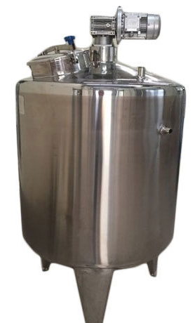
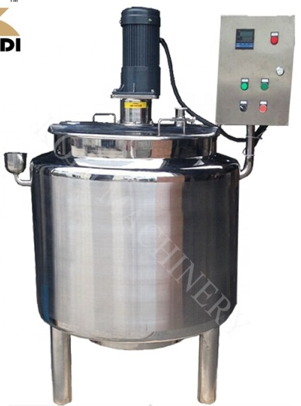
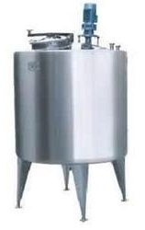
SS AGITATOR MIXER TANKS
Ch. Amjad Ali
Chief Executive
Ref#: AAE/21/374
We are manufacturer of following agitator mixer tanks
1.Cosmetic and Chemical Product:
Cosmetic cream, lotion, shampoo, detergent, health care product, gel, Laundry detergent, hand sanitizer, armpits lotion etc.
2.Pharmaceutical product:
Ointment, Ice packs, injection liquid, penicillin etc.
3.Food :
Salad, mayonnaise, peanut butter, sesame butter, buttery, Animal fat, iced products, healthy food etc.
4. Beverage:
Fruit Juice, Milk Juice etc.
5.Chemical:
Paints, Pigments, dyes, photo solvents,
Rubber and resin, pesticides ,Shoe polish,
general chemicals etc.

