Slide 1

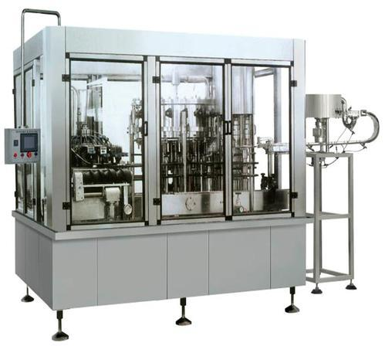
juice filling machine
Ch. Amjad Ali
Chief Executive
Ref#: AAE/21/368
Product Description
It is a kind of advanced filling machine integrator which is innovated in all process requirements of filling glassy beverage based on the importing and assimilating the foreign advanced technology.
Working speed can be adjusted by frequency conversion device.
Size of bottle: 500ml (300ml-1500ml) not returnable square or round pet bottle. Closure type: 28~38mm standard plastic screw caps

