Slide 1

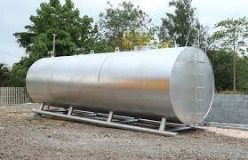
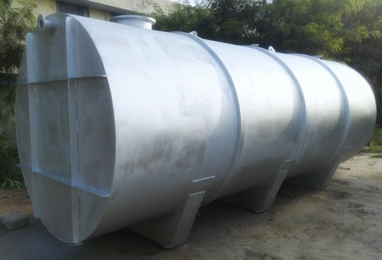
SS OIL STORAGE TANK
Ch. Amjad Ali
Chief Executive
Ref#: AAE/21/373
SS Oil Storage Tanks are used for storing various types of Edible Oil like Refined Oils, Mustard Oil, Olive Oil, Coconut Oil, Soyabean Oil etc. Essential Oils can also be stored in these tanks like Sandalwood Oil, Eucalyptus Oil, Almond Oil, Tea tree Oil, Clove Oil etc. These tanks are made in Stainless Steel 304/316 only as the oils are used for human consumption. Oil Storage Tanks are also used for storing Non-Edible Oil like Petrol, Diesel, Furnace Oil, Lubricant Oils and for storing these oils Mild Steel is preferably used.
PRODUCT SPECIFICATION
Storage Material | Chemicals/Oils
Capacity (litres) | 10000-50000 L
Tank Material | Stainless Steel
Material | SS304 OR MS
Type | Vertical, Horizontal
Shape | Cylindrical, Round
Application | Oil Storage

