Slide 1

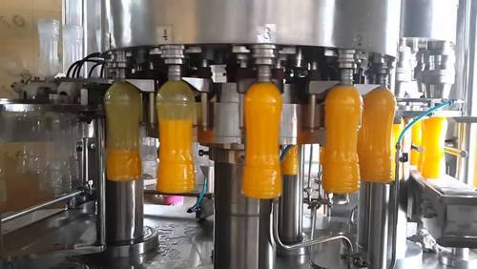
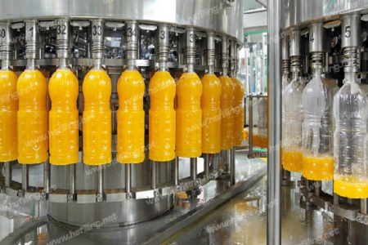
Juice & Beverage Machinery
Ch. Amjad Ali
Chief Executive
Ref#: AAE/21/258
Juice Bottle Filling Machine with excellent quality and productivity with numerous outstanding features. Filling of juice at high temperature with provision of washing, filling & capping. Excellent machine with mostly use in sophisticated process and as per GMP.
Capacities vary from 30 bottles per minute (BPM) to 1000 BPM.
Rinsing
Filling
Capping
Minimum Order Quantity | 1 Unit
Automation Grade | Automatic
Packaging Type | Bottles
Color | Silver
Orientation | Vertical
Voltage (Volt) | 220

