Slide 1

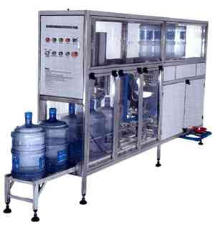
Mineral Water Filling Machine 19 Liter
Ch. Amjad Ali
Chief Executive
Ref#: AAE/21/266
Product Specification
Capacity | 19 liter Rinsing, Filling and Capping
Machine Type | Automatic
Material | SS 304 frame structure.
Driven Type | Electric
Features:
Automatic 19-liter Bottle Rinsing, Filling and Capping Machine.
Fully automatic linear PLC based on 19 ltr. Bottle/Bubble top.
Out Put Speed of 100 BPH.
Pressure Pump Wash ensures proper washing.
Diving Type filling nozzle ensures no spillage of water, timing base filling system.
Cap Pressing by pneumatic cylinder for proper capping.
9 Feet length/7.5 feet height and 3 feed with.
2.0 HP for washing and filling / 1.0 HP for the conveyor.
Machine fully in SS - 304 and product contact parts in SS - 316
The machine can be tailor - made as per floor space availability.
UV sterilization for caps before capping operations.
Screw or press-fit capping can also be done.

