Slide 1

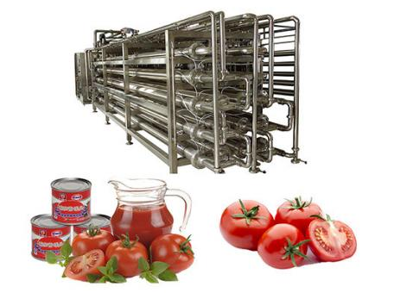
TOMATO SAUCE /PULP
PROCESSING MACHINE
Ch. Amjad Ali
Chief Executive
Ref#: AAE/21/235
Raw material handling capacity(t/d) | 60 | 150 | 250 | 500 | 750 | 1000 | 1250 | 1500 | 2000
Evaporation Form | Double vacuum | Double vacuum | Three vacuum | Three vacuum | Three vacuum | Three vacuum | Three vacuum | Three vacuum | Three vacuum
Water Consumption | 7.1 | 13.1 | 21.6 | 44.3 | 65.7 | 44.3 | 65.9 | 65.9 | 79.08
Power(kw) | 83.8 | 151.5 | 412.4 | 636.2 | 955.4 | 1291.6 | 1411.1 | 1558.1 | 1869.7
Steam Consumption(t/h) | 1.665 | 3.87 | 5.22 | 9.14 | 15.01 | 20.2 | 24.62 | 29.15 | 34.98
Compressed Air Consumption(t/h) | 66.2 | 66.2 | 66.2 | 72.2 | 72.1 | 72.2 | 72.2 | 72.2 | 86.84
Cooling Water Consumtion(t/h) | 125 | 317 | 307 | 585 | 825 | 1075 | 1410 | 1630 | 1956

