Slide 1
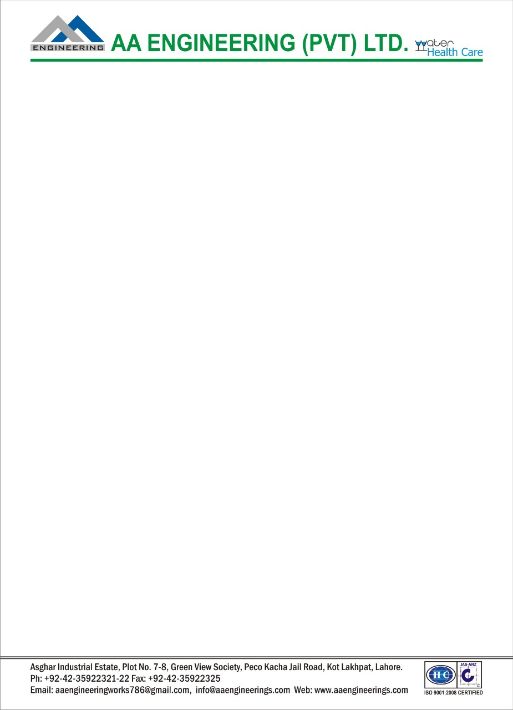
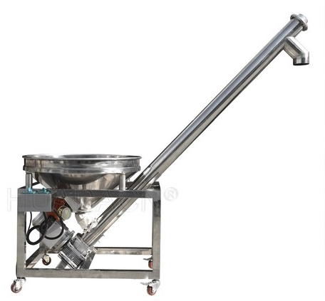
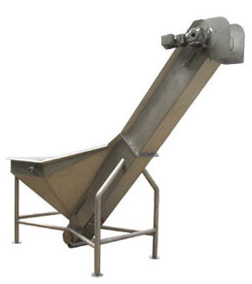
Ch. Amjad Ali
Chief Executive
Ref#: AAE/21/212
SS SCREW CONVEYOR FEEDER
Product Description:
Screw Feeder for Powders features:
Screw feeding system for feeding the material into upper hopper of filling machine.
Suitable for all type of powders such as Spices, Milk Powder, Flour, Paints, Clay powder, China Powder, Pesticides and other powder products.
Open Close type feeders as per requirement.
All contact parts are made of stainless steel / Mild steel.
Main hopper capacity - 50 to 500 Kgs. (Depends upon density of material).
Automatic material controlling in overhead hopper.
Size as per Client’s demand.
Surfaced Polish
Voltage 220/240V
Frequency 50Hz
Mob# 0300-8044336

