Slide 1

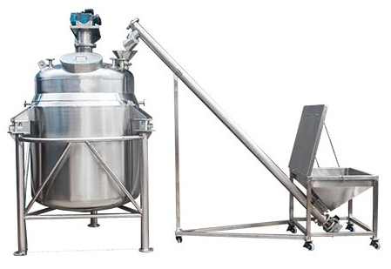
Ch. Amjad Ali
Chief Executive
Ref#: AAE/21/211
SYRUP MANUFACTURING TANK
WITH SCREW FEEDER
Product Description:
We are the manufacturer of Syrup Manufacturing Tank With Screw Feeder in all Pakistan. It is used for manufacturing sugar & liquid glucose syrup to produce consistent quality candies, toffees & eclairs.
Syrup Manufacturing Tank With Screw Feeder has:
Voltage: 415 - 440 V,
Frequency: 50 Hz,
Material: SS 304
Drive output: 1.5 HP to 5 HP.
Mob# 0300-8044336

