Slide 1
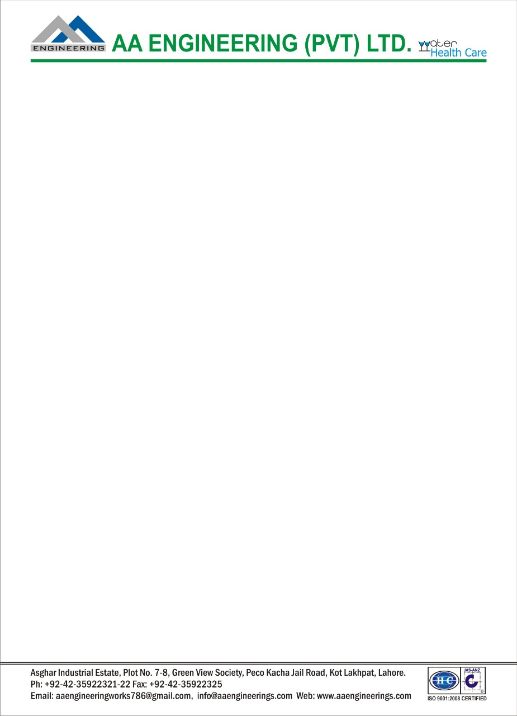
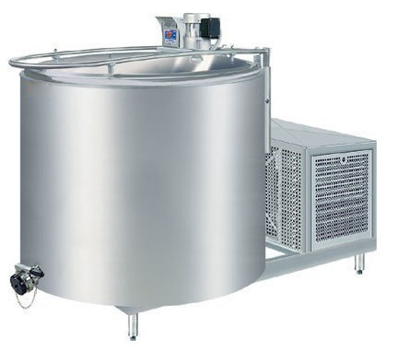
SS Chiller 500 liter
Ch. Amjad Ali
Chief Executive
Ref#: AAE/21/201
Description:
Capacity : 300-500 Liter
Storage Material : Milk
Dimension (As required) : Dia900mmx1000mmx1.5mm Th (Approx.)
Voltage : 220V / 380V
Frequency : 50Hz
Design Type : Standard, Customized
Machine Body Material : Stainless Steel
Thickness of Insulation : 50 mm
Connected Load : 1500-2000 Watt
Working temperature : 0 - 40 Degree C
Salient Features:
Faster cooling owing to direct expansion
Robust design
Durable tank made of AISI 304
Hermetically sealed compressor
Digital temp controller
Occupy minimum space
Energy conscious
Designed to be user friendly
Mob# 0300-8044336

